Slide 1
CPE 133
More Verilog Details
Structural Modeling
Ripple Carry Adders
Experiment #3

Slide 2
Verilog Data Types
Scalar quantities
Vector quantities
module my_ckt (A,B,C,D,F);
input A,B,C,D;
output F;
assign F = (A & ~B) | (C & ~D);
endmodule
module my_ckt (A,B,C,D,F);
input [3:0] A,B,C,D;
output [3:0] F;
assign F = (A & ~B) | (C & ~D);
endmodule

Slide 3
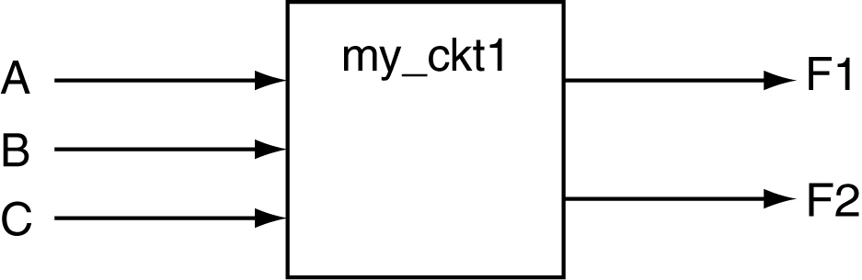
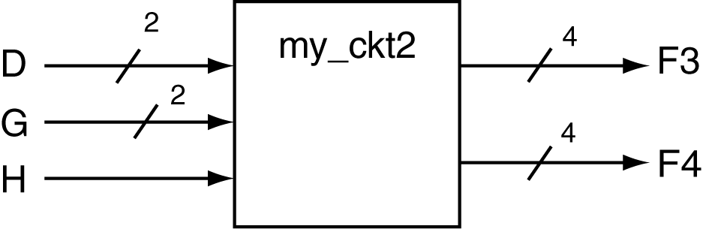
Example: entity declarations
module my_ckt1 (A,B,C,F1,F2);
input A,B,C;
output F1,F2;
//- statements
endmodule
module my_ckt2 (D,G,H,F3,F4);
input [1:0] D,G;
input H;
output [3:0] F3,F4;
//- statements
endmodule

Slide 4
Digital Design Issues
An approach to digital design:
Define the problem: understand the starting point and requirements
Describe your solution to the problem: propose your path to the solution
Implement your solution to the problem: embodiment of the solution
Main Design approaches:
BFD – brute force design (iterative design)
IMD – iterative modular design
MD – modular design

Slide 5
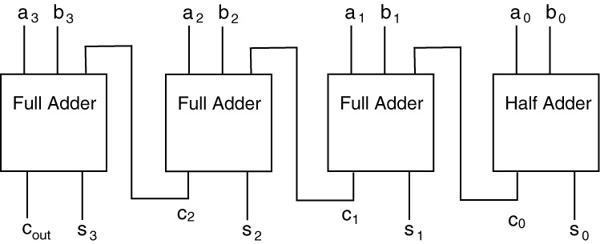
4-bit Ripple Carry Adder
Implement using Verilog Structural Modeling
Use at least two-levels in your design
Use bundle notation (not individual signals)
Don’t simulate

Slide 6
RCA Foundation Module
Generic Digital Circuit
RCA Foundation Module Notation

Slide 7
Experiment 3: 5-bit Ripple Carry Adder
Make it incredibly neat and organized
Indentation provides information
This is true digital modeling (hierarchical)
Verilog structural modeling
Initially syntactical pain in the @#%$
Use bundles (buses) whenever you can
Inputs operands & Sum output
Internal signals?

Slide 8
Verilog Structural Modeling
Supports hierarchical design
Boxes within boxes
the only way to understand and/or implement a complex digital circuit
Similar approach to good programming
module reuse
functional hierarchy

Slide 9
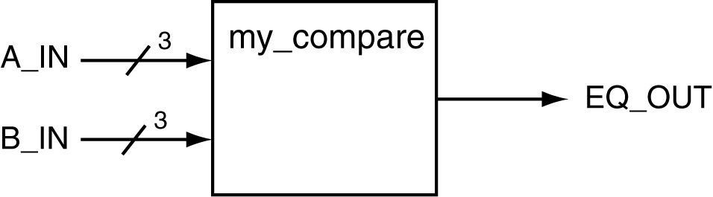
3-Bit Comparator

Slide 10
//- defintion of XNOR gate
module my_xnor(A, B, F);
input A,B;
output F;
assign F = ~(A ^ B);
endmodule
//- definition of 3-input AND gate
module my_and(A, B, C, F);
input A, B, C;
output F;
assign F = A & B & C;
endmodule

Slide 11
//- defintion of XNOR gate
module my_xnor(A, B, F);
input A,B;
output F;
assign F = ~(A ^ B);
endmodule
//- definition of 3-input AND gate
module my_and(A, B, C, F);
input A, B, C;
output F;
assign F = A & B & C;
endmodule
//- definition of 3-bit comparator
module comp_3b(A,B,EQ);
//- external interface signals
input [2:0] A,B;
output EQ;
//- internal interface signals
wire [2:0] m;
//- XNOR instantiations
my_xnor XNOR2 (
.A (A[2]),
.B (B[2]),
.F (m[2]) );
//- XNOR instantiation
my_xnor XNOR1 (
.A (A[1]), .B (B[1]), .F (m[1]) );
//- XNOR instantiation
my_xnor XNOR0 (
.A (A[0]), .B (B[0]), .F (m[0]) );
//- AND instantiation
my_and AND0 (
.A (m[2]), .B (m[1]), .C (m[0]), .F (EQ) );
endmodule

